Slide 1


Study and development of a Validation Facility for the SST camera of the CTA observatory
Candidate: Isabella Sofia
Supervisor: Prof. Andrea Chiavassa
Co-supervisor: Dr. Davide Depaoli
Co-examiner: Prof. A. Ferretti

Slide 2
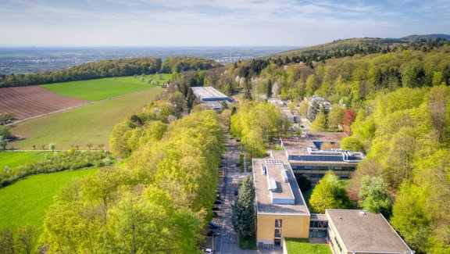
Summary
Brief γ-ray astronomy and IACT introduction
CTA and SST, CHEC-S
The validation facility at MPIK
Goals
Experimental set-up
Study of components
The Night Sky Background (NSB)
The Filter Wheel and its calibration
The laser beam model (Robot Arm)
CHEC-S: an SST prototype
CHEC-S in the DarkBox
Trigger Delay
HV settings
Conclusions and outlooks

Slide 3
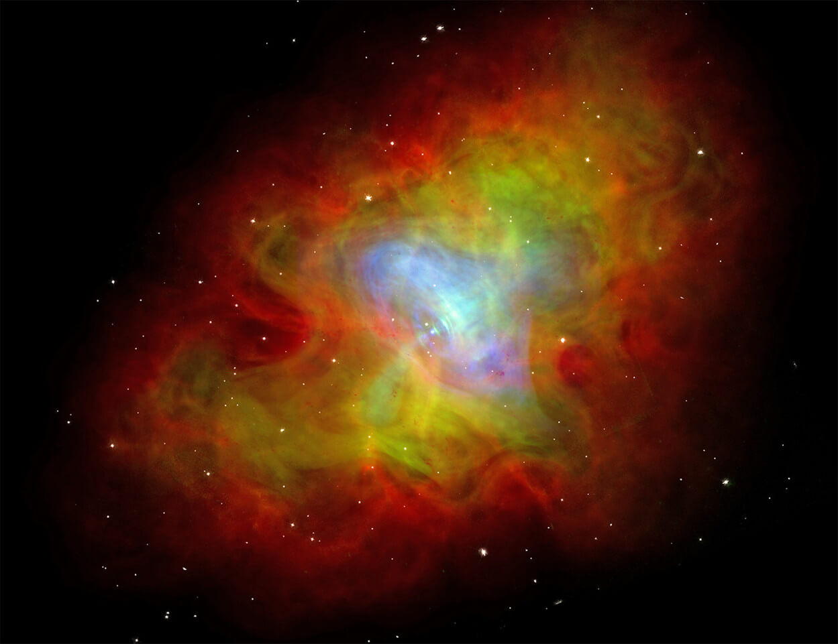
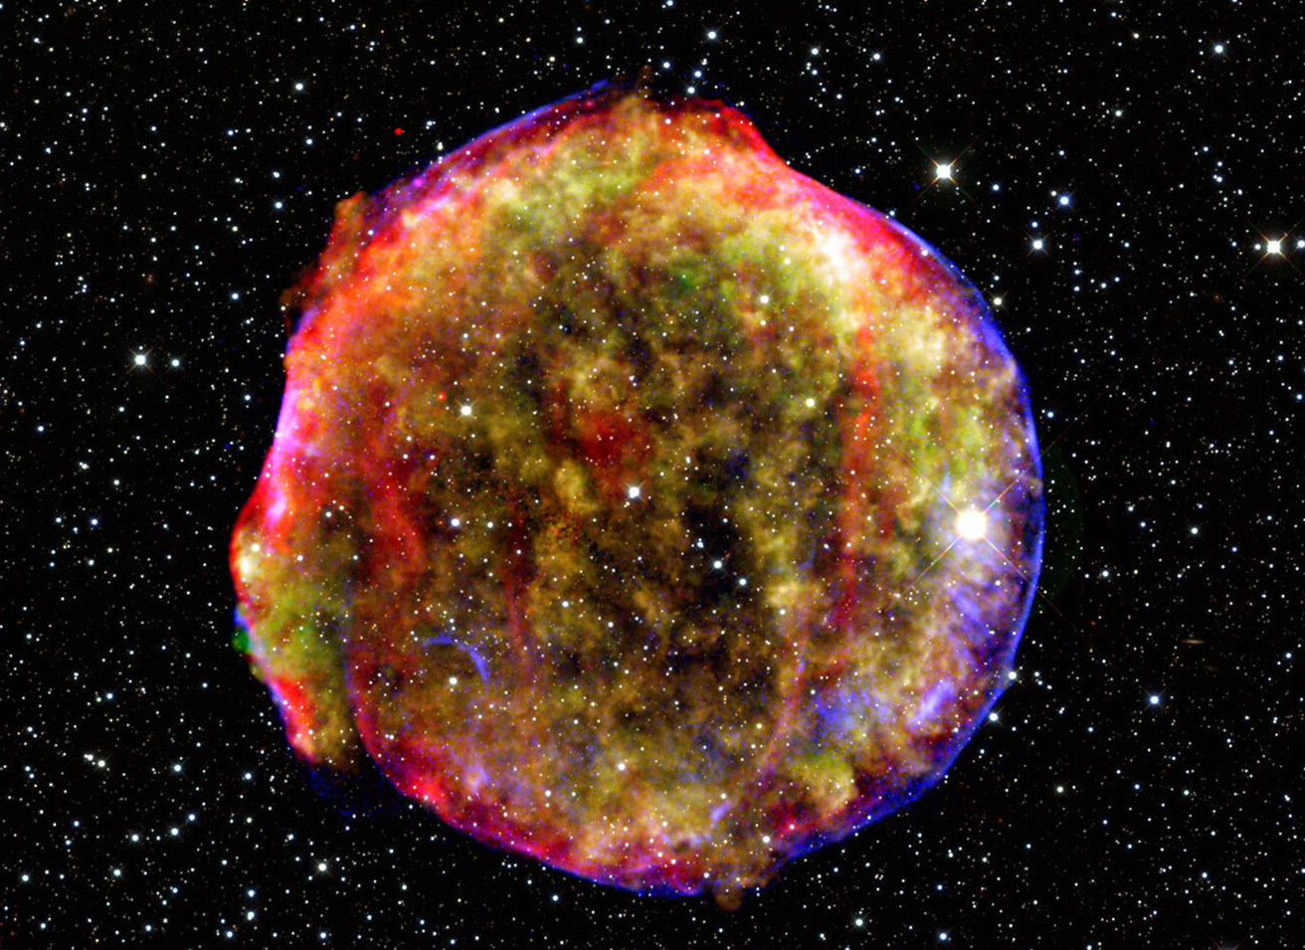
Neutral cosmic messengers: gamma rays
Neutral messengers: photons
Massless
Not influenced by magnetic fields
Point back to their sources
Scientific goals
Identify cosmic rays’ sources
Study and understand the origin of such cosmic rays
Probe peculiar environments (SNRs, pulsars, AGNs, PWNs, …)
New physics (e.g. Dark Matter)
Methods of detection
Direct: satellite experiments
Indirect: ground-based
Crab Nebula Pulsar (top) and Tycho’s SNR (bottom)

Slide 4
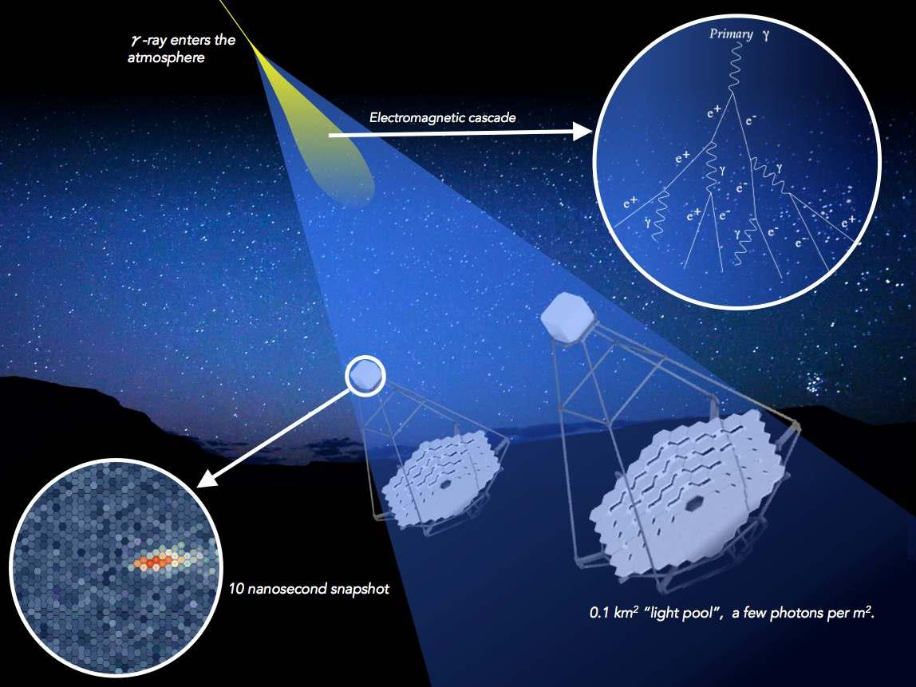
IACT technology
Imaging Atmospheric Cherenkov Telescopes
Ground-based experiments
Use the Earth’s atmosphere as a «sampling calorimeter»
Detect the Cherenkov light produced by electromagnetic showers
It is possible to reconstruct:
Direction
Energy
Allows excellent γ-hadron separation
Low Duty Cycle
Limited field of view

Slide 5
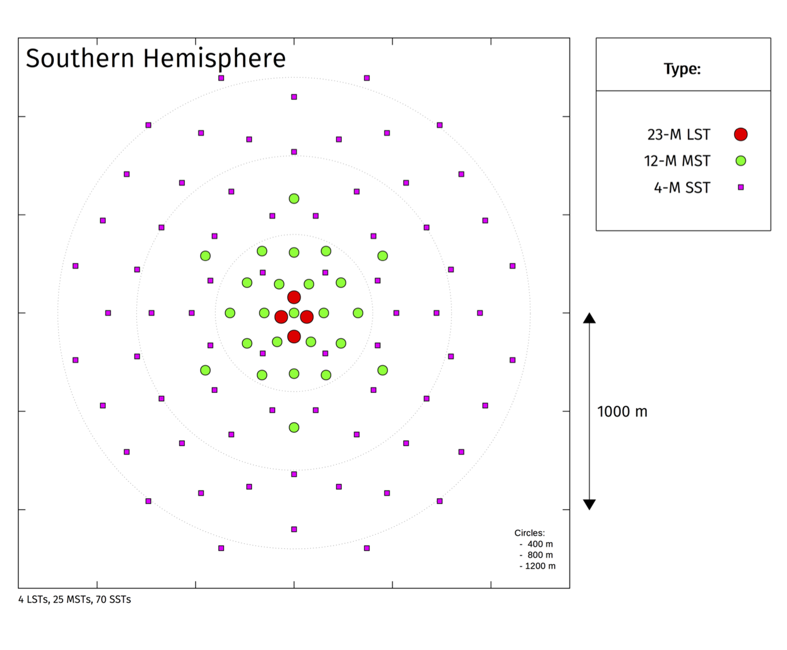
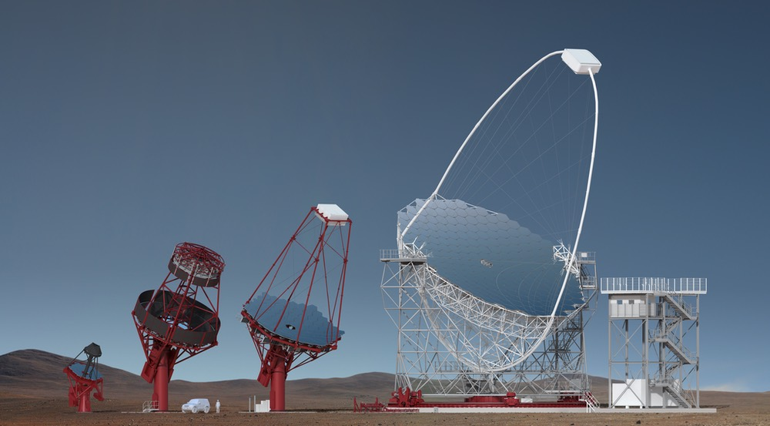
The CTA Observatory
Cherenkov Telescope Array
Next generation IACT observatory
A northern and a southern hemisphere site to cover the whole sky
Roque de los Muchachos, la Palma, Canary Islands, Spain
Chile
Wide energy range: 20 GeV - 300 TeV
Three telescope classes with different mirror diameter
Small-sized (SST) – 4 m
Medium-sized (MST) – 12 m
Large-sized (LST) – 23 m

Slide 6
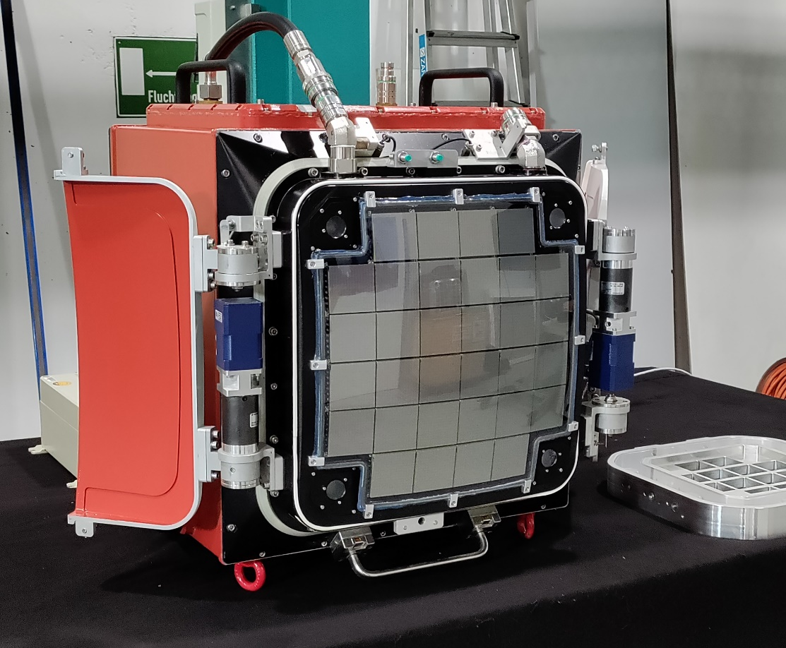
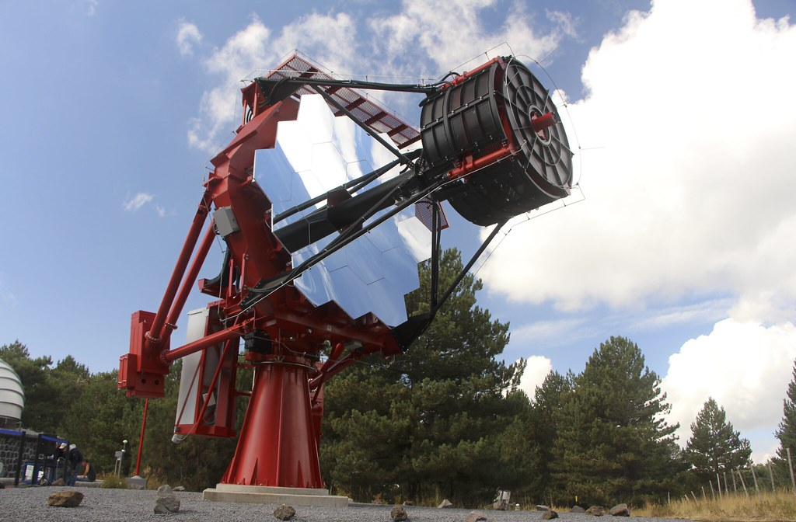
SST – Small-Sized Telescopes
On southern site only
Sensitivity range from ≈ 1 TeV to 300 TeV
Three different SST structures were proposed (SST1-M, ASTRI-Horn, CHEC)
Final design: ASTRI (telescope structure) + CHEC-S (detector)
Dual-mirror Schwarzschild–Couder design (only SSTs)
SST camera working rate of ≈ 600 Hz
CHEC-S
ASTRI telescope structure

Slide 7
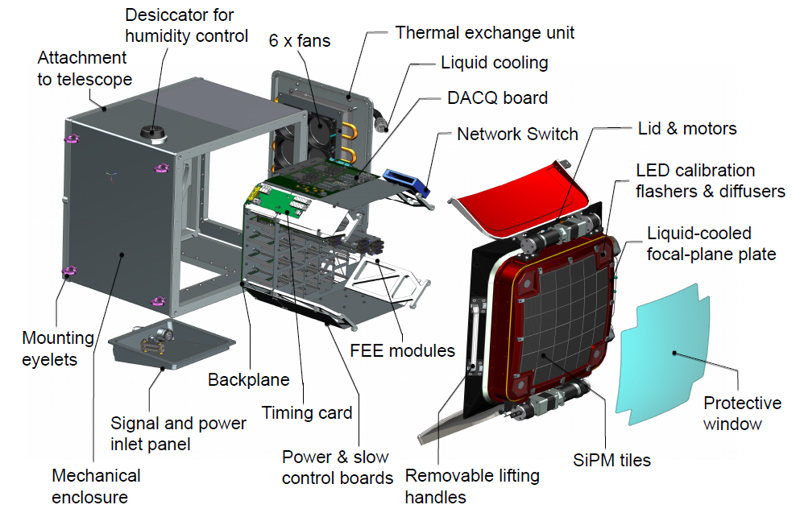
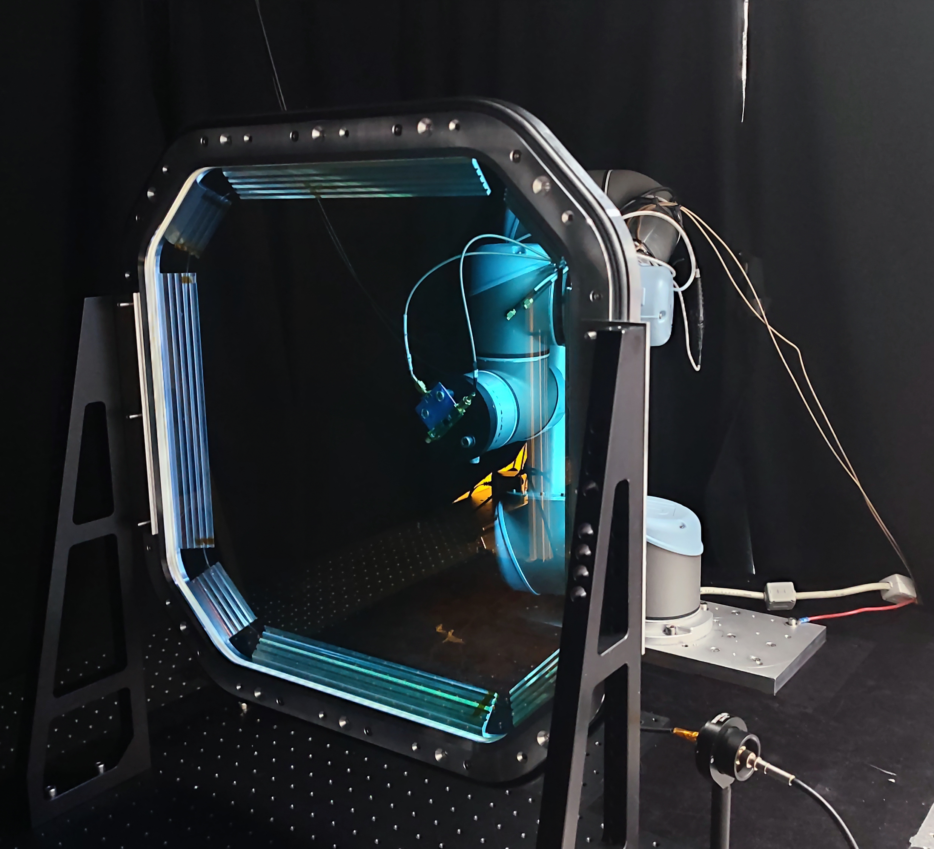
CHEC-S
Compact High Energy Camera
Proposed prototype for the dual-mirror SST design
SiPM-based (Hamamatsu S12642-1616PA-50 SiPMs)
2048 pixels distributed on 32 modules, each comprising 64 pixels of 6 mm ×6 mm
Final SST Camera design will be CHEC-S-like, plus…
Improved cooling and air flow
Glass window
Filter on window
New SiPM technology (S14521-1720)
J. Zorn
CHEC-S prototype
New flat window

Slide 8
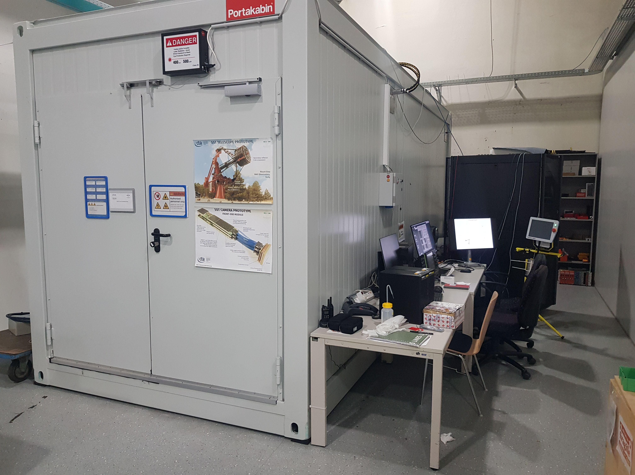
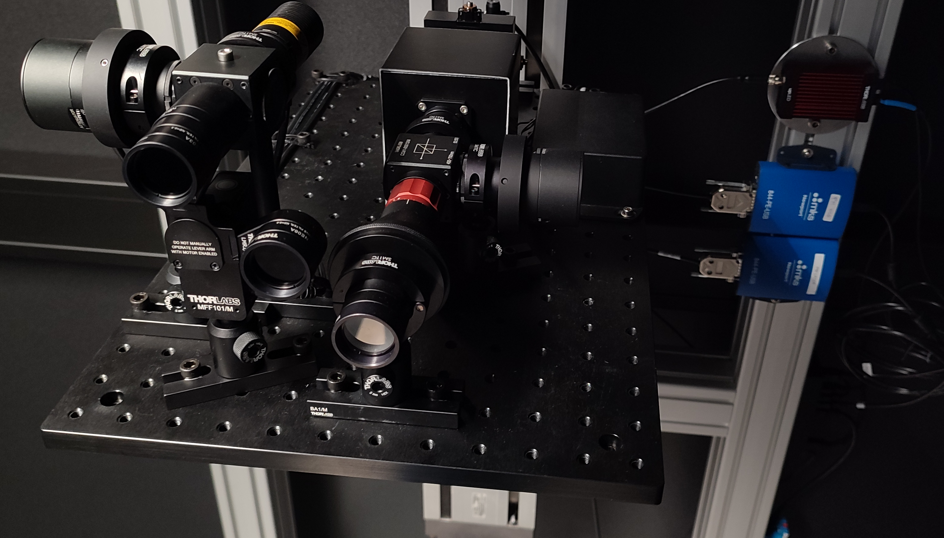
Validation Facility – «DarkBox»
≈ 42 SST Cameras to be developed
Validation for each newly produced camera is needed
The «Validation Facility» (DarkBox) at MPIK will
Provide a dark room for measurements
Simulate a certain range of background light coming from the sky (NSB)
Simulate the Cherenkov light (Laser)
Be completely remotely-controlled by the user (via the DarkBox Manager Software)
Be a stable and well-known environment to test each SST camera
Validation Facility at MPIK Laboratories
Optical set-up

Slide 9
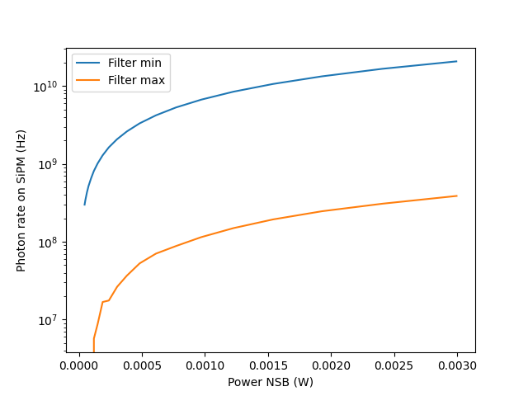
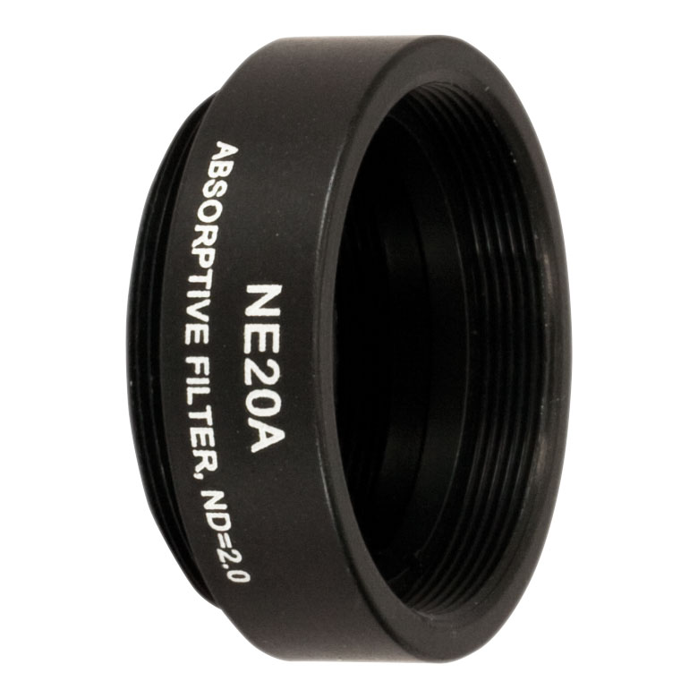
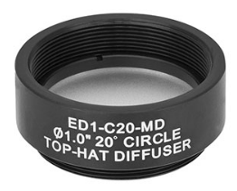
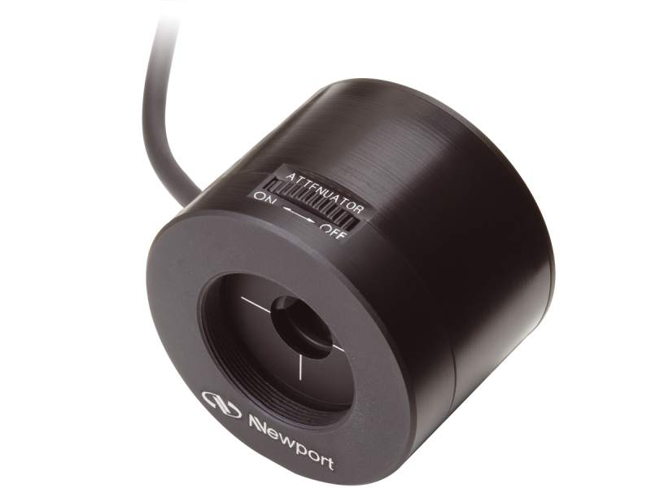
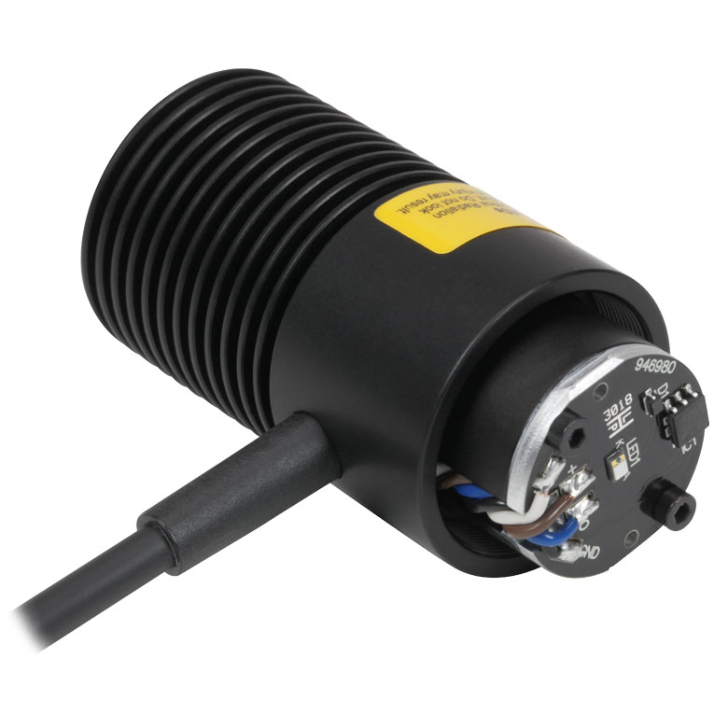
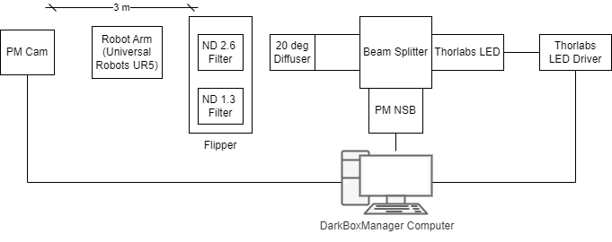
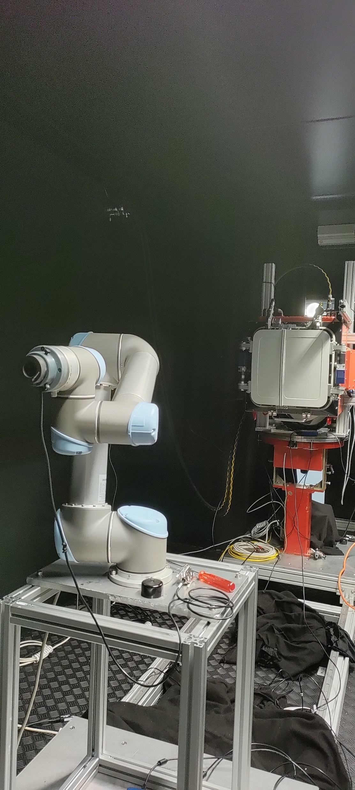
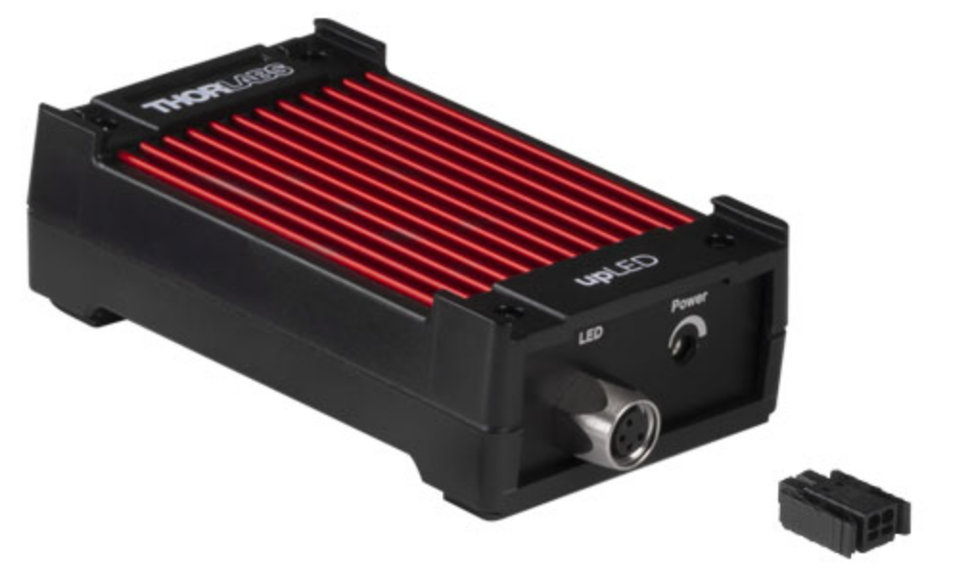
Simulating the NSB – set-up
Use of a DC LED
NSB is a diffused radiation → use of a 20° diffuser
Use of two different ND filters in order to cover a range between ≈10 MHz to ≈ 20 GHz
Powermeter at NSB for feedback loop
Photon rate on SiPM VS Power at NSB source

Slide 10
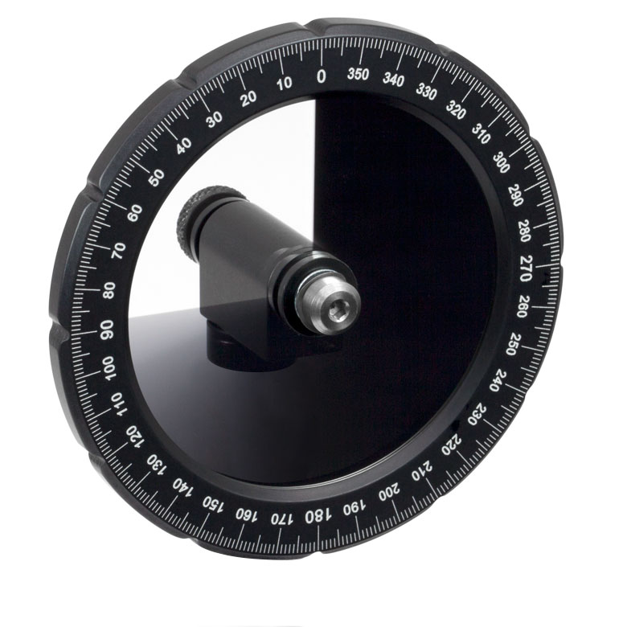
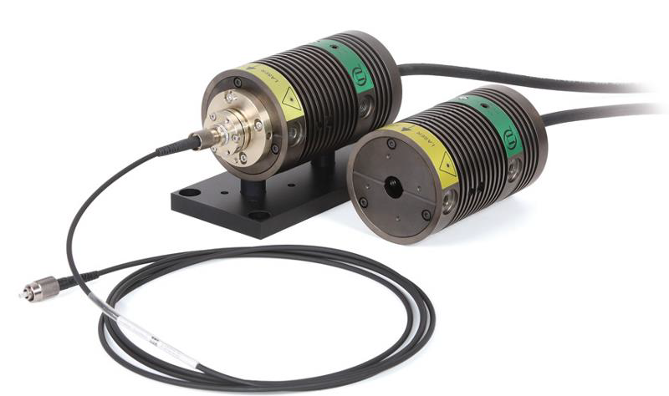
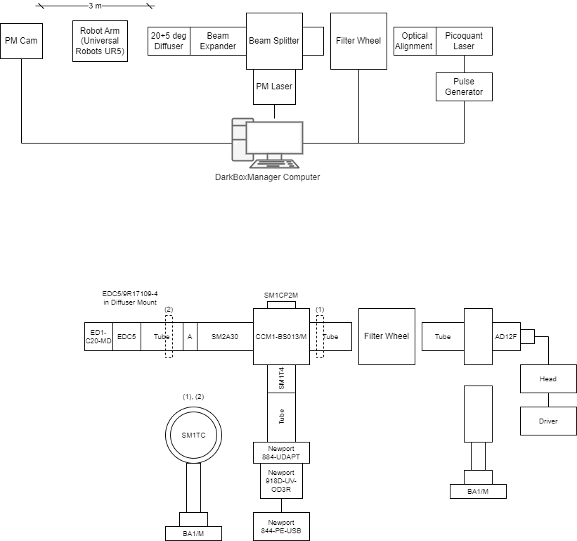
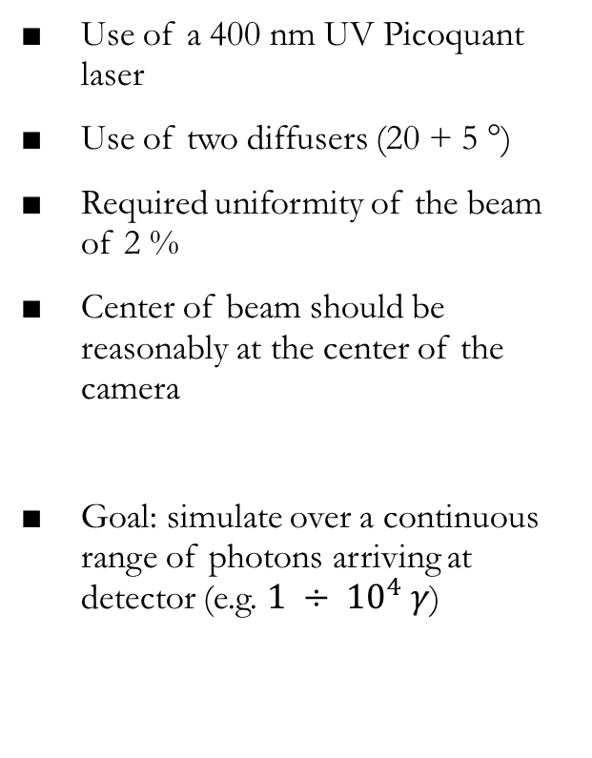
Simulating the Cherenkov light - laser
Use of a 400 nm UV Picoquant laser
Use of two diffusers (20 + 5 °)
Required uniformity of the beam of 2 %
Center of beam should be reasonably at the center of the camera
Goal: simulate over a continuous range of photons arriving at detector (e.g. $1 ÷ {10}^{4} γ$)

Slide 11
Providing a wide range of photon rate – the Filter Wheel
Laser light intensity should remain constant (stability issues)
Filter Wheel: continuously variable neutral density filters that provide attenuation
Controlled with the DBM Software (via ethernet)
Attenuation can be adjusted linearly via rotation
Attenuation covers 4 orders of magnitude (OD 0.04 – 4.0)
Calibrating the filter wheel means knowing how many photons we can expect at camera position at each step on the FW at the SST working rate
To obtain this: study the filter wheel range, i.e. “calibrate” the filter wheel

Slide 12
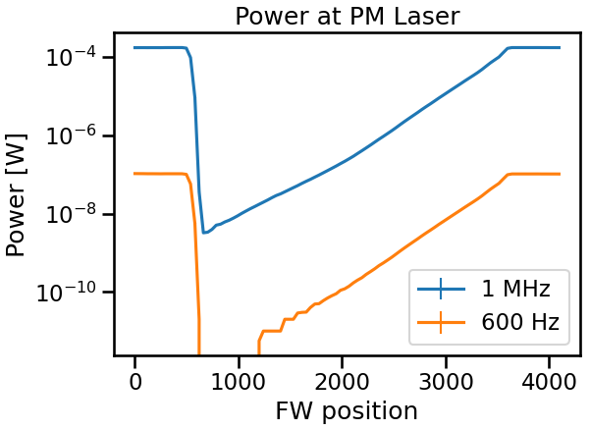
Filter Wheel «calibration» - procedure
Powermeter measurements at camera position (3 m) at 600 Hz are quite difficult (powermeter sensitivity ≈ pW)
Hence, two sets of data are needed
One at the working rate (600 Hz)
Another one at a higher rate (1 MHz)
With these, we can obtain the expected number of photons at camera position at working rate for each FW position
Interpolate the result on all FW positions that yield at least 1 photon
Save the interpolated values in a calibration file to be included in the DarkBox Manager Software.
Power measured at laser position

Slide 13
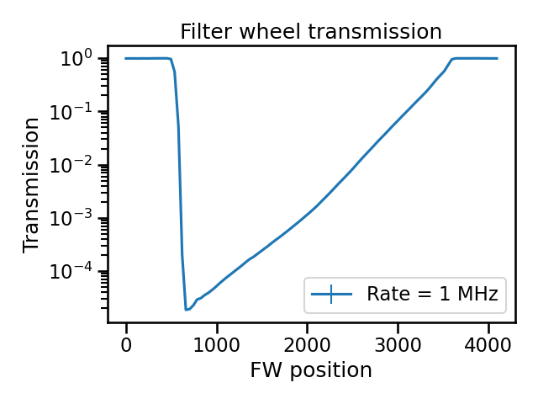
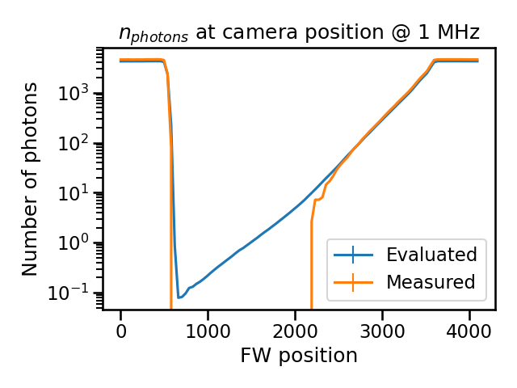
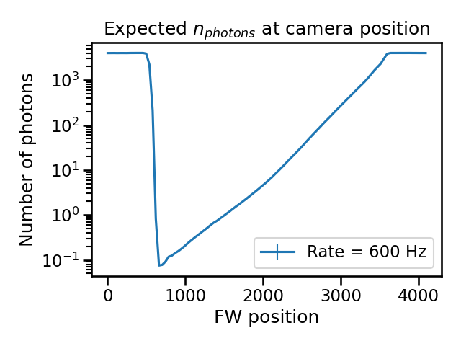
FW calibration procedure
Transmission (laser measures)
Number of photons at 3 m from source, 1 MHz
Number of photons at 3 m from source, 600 Hz
Dynamic range of laser source: 1 γ → 4000 γ

Slide 14
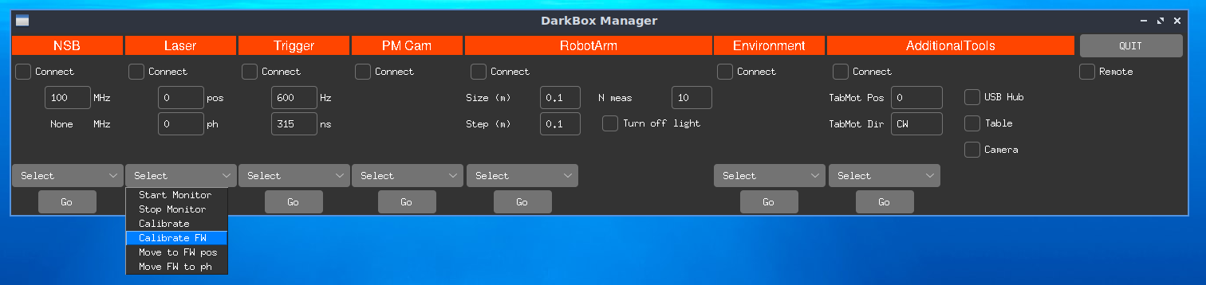
Procedure automatization
The facility will often be monitored: need to automatize this procedure in order to have always the updated configurations
Implementation of «Calibrate Filter Wheel» in the DarkBoxManager
The user can, at anytime, run the procedure directly from the DarkBoxManager GUI. Said procedure will
Take the needed runs of data
Perform the described analysis
Return a new calibration file to be set

Slide 15
Beam Model
Uniformity requirement at 3 m from source
Use a Robot Arm to scan the laser beam on a circular area of maximum radius of 0.30 m (step 1 cm)
Tried different optical combinations to obtain uniformity at 3 m
Final combination: 20° + 5° diffusers and beam expander

Slide 16
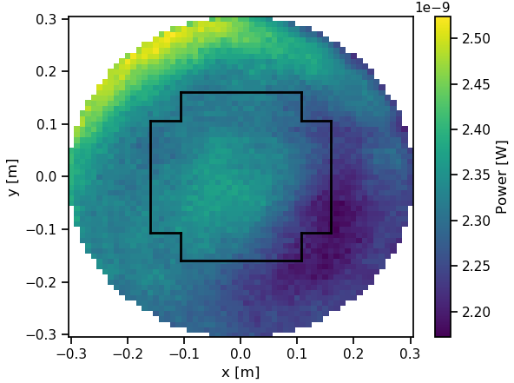
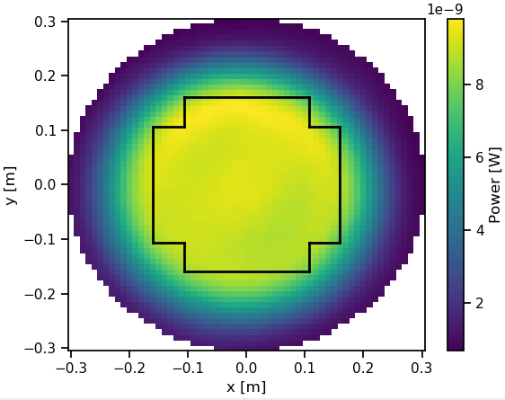
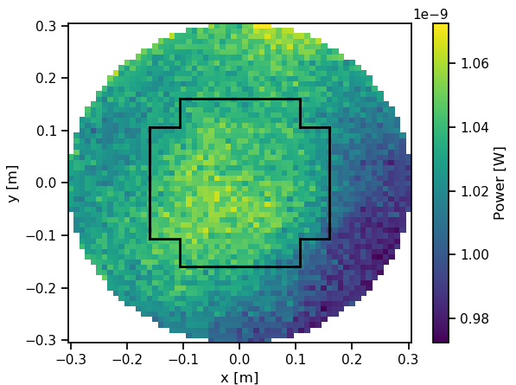
2D scans
1 m
2 m
With final optical combination uniformity at 3 m is about 1 %
We can study the resulting beam
Is it reasonably centred?
How do the optical diffusers work?
Are we able to describe the laser beam in some way near the source?
→ several fits, both one and two dimensional
→ Which function works best?
3 m

Slide 17
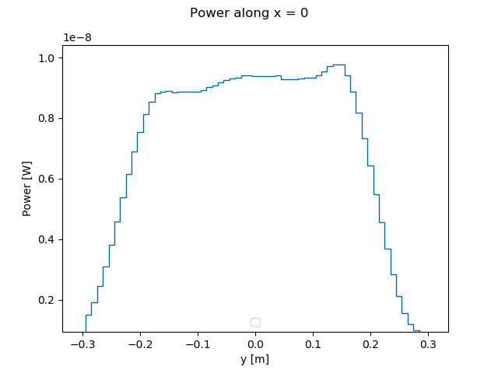
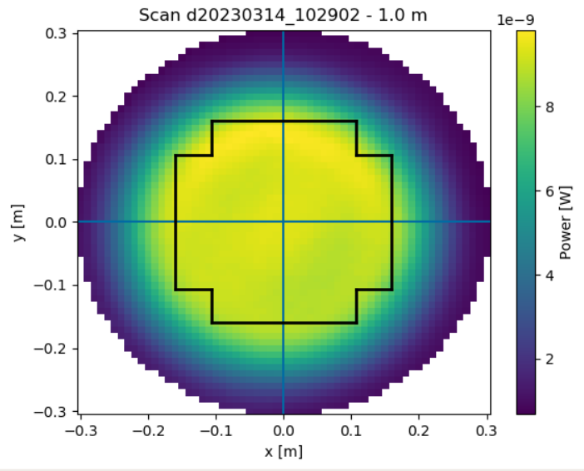
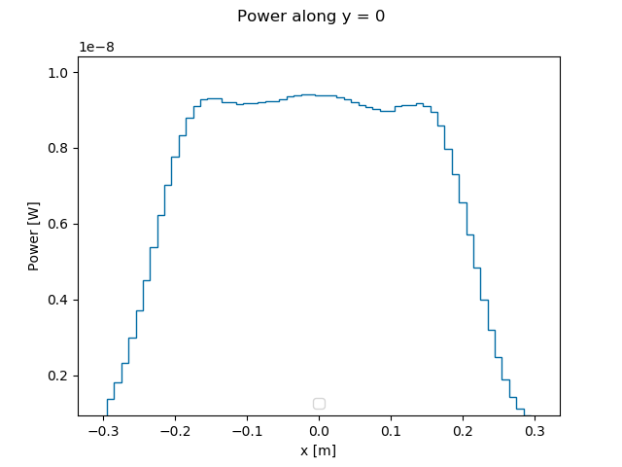
Starting point – data
Slicing along x = 0
Slicing along y = 0
Idea
The laser light is emitted as a gaussian beam
Diffusers are «circular tophat» diffusers

Slide 18
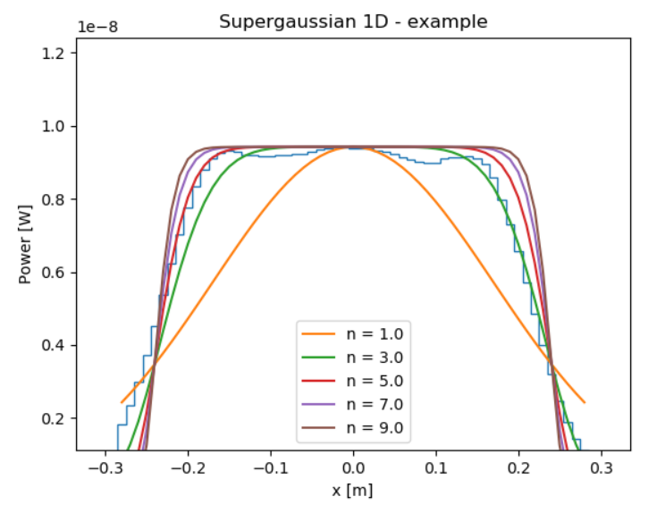
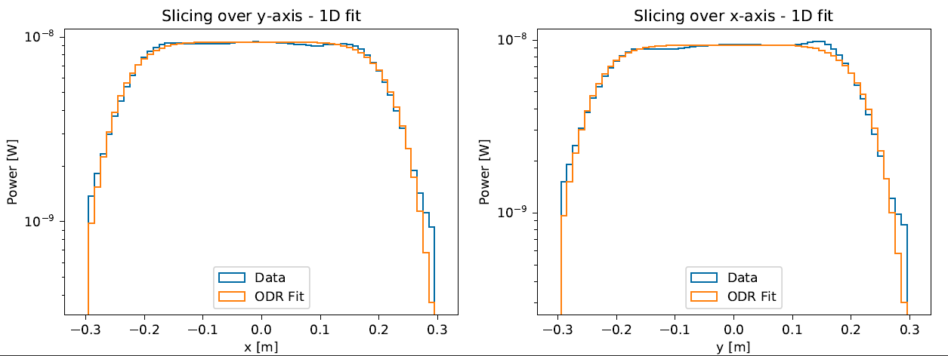
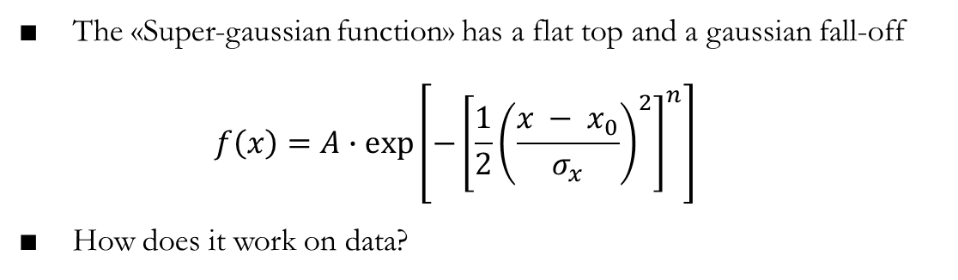
Supergaussian distribution
The «Super-gaussian function» has a flat top and a gaussian fall-off $f\left(x\right)=A∙exp\left[−{\left[{\frac{1}{2}\left(\frac{x − x_{0}}{σ_{x}}\right)}^{2}\right]}^{n}\right]$
How does it work on data?
Data: slice along y = 0
A supergaussian distribution seems to work quite well on our experimental data

Slide 19
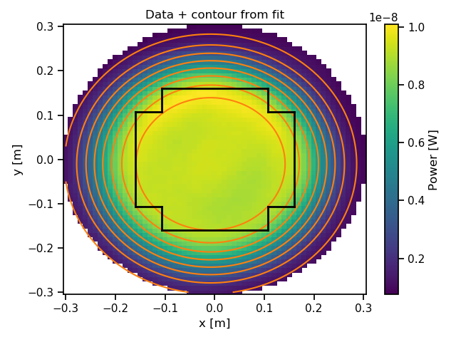
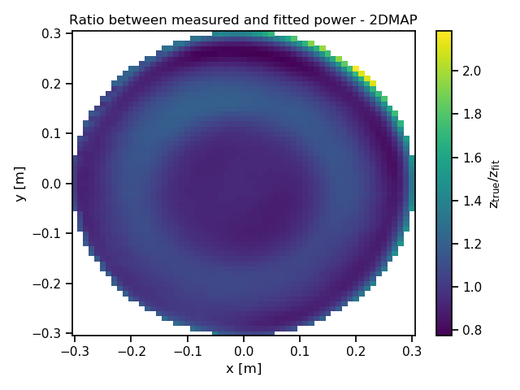
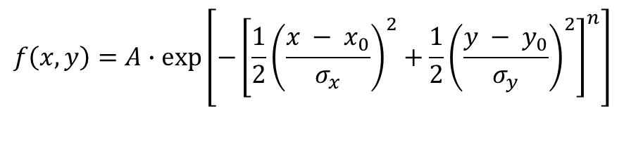
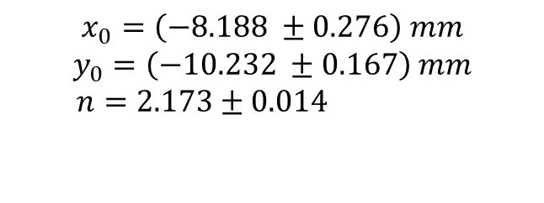
Results @ 1 m – 2D
$$f\left(x, y\right)=A∙exp⁡\left[−{\left[{\frac{1}{2}\left(\frac{x − x_{0}}{σ_{x}}\right)}^{2}+{\frac{1}{2}\left(\frac{y − y_{0}}{σ_{y}}\right)}^{2}\right]}^{n}\right]$$
$$x_{0}=\left(−8.188 ±0.276\right) mm$$
$$y_{0}=\left(−10.232 ±0.167\right) mm$$
$n=2.173±0.014$

Slide 20
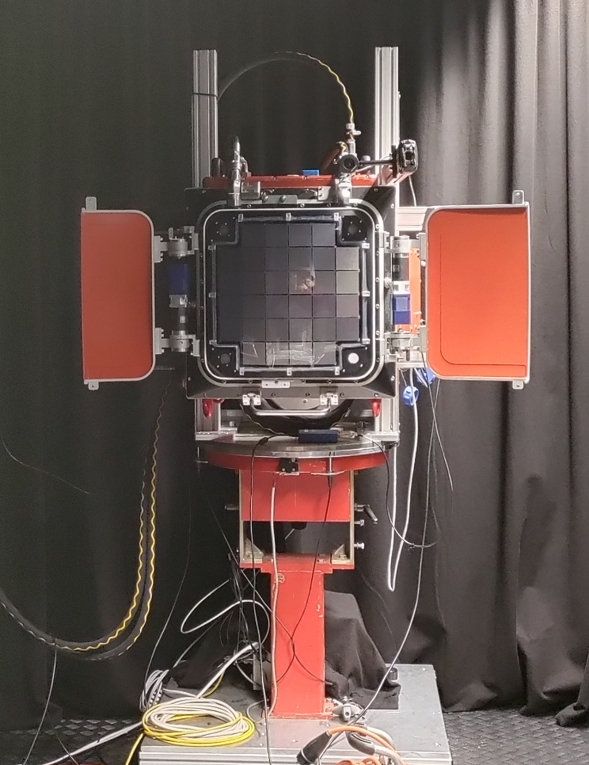
CHEC-S in the DarkBox
Experimental set-up
Camera positioned on a rotational stage
Indipendent power supply
External chiller
Data carried by an optical fiber
Always used external triggering
Goals
«Take back to life» the camera
Find the signals (i.e. trigger delay)
Update HV settings (last config file: commissioning in Sicily, 2019)
In a nutshell: put to test CHEC-S and the DarkBox set-up

Slide 21
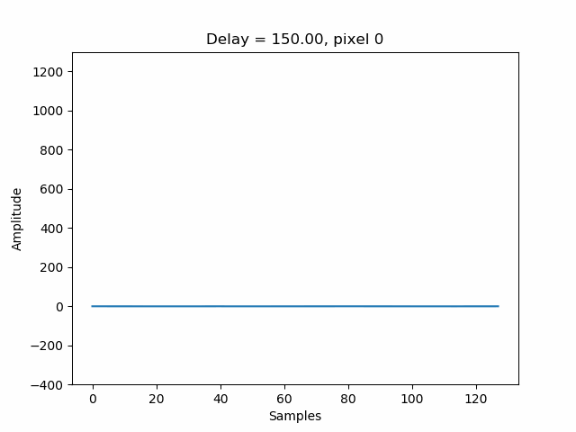
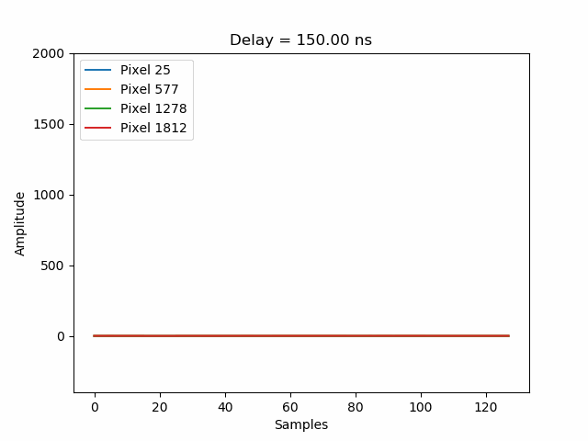
CHEC-S - Delay
Use of various cables to externally trigger the camera → need to find the right «trigger delay» to be set for next measurements, i.e. find the peak of the signal
Implementation of a «delay scan»
Quick analysis to find the peak and visualize it, potentially pixel per pixel
Delay of 300 ns
Python script can be run at anytime if set-up is modified
Here also some «dead» pixels are expected…

Slide 22
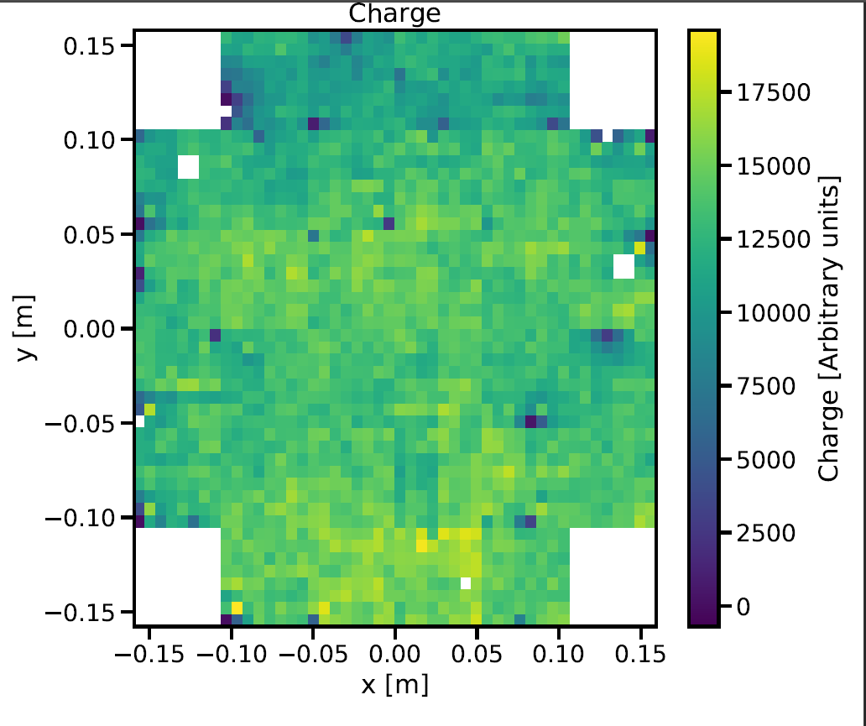
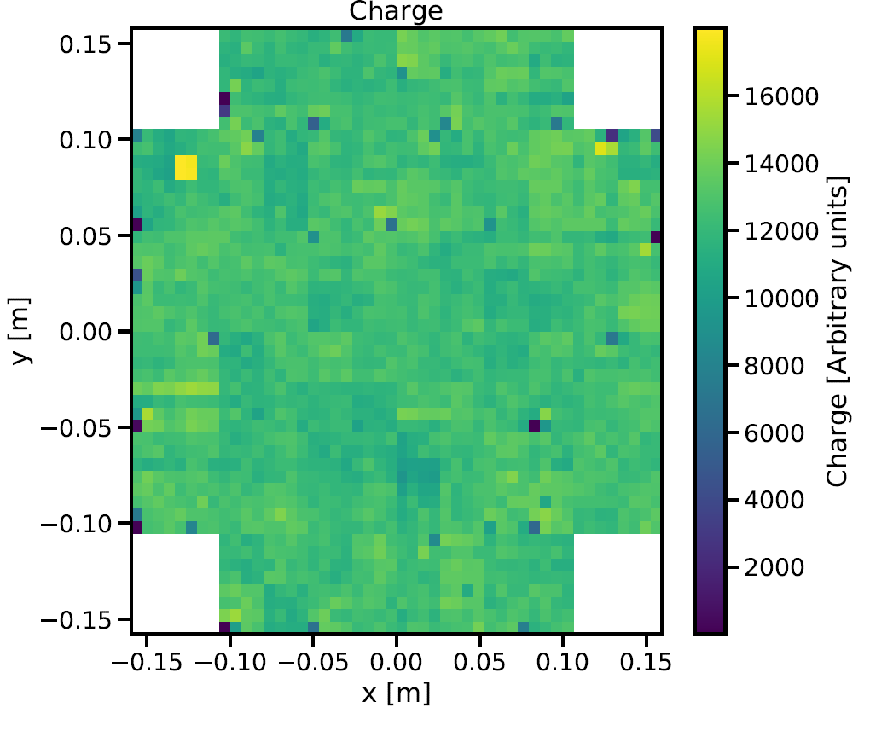
CHEC-S – HV settings
Amplitude matching: equalize the response to a Cherenkov or laser signal of same intensity between all pixels.
Iterative procedure
Should also improve the extracted charge uniformity between pixels of camera
Before HV settings update
(input of 2000 photons)
Uniformity 17.52 %
New HV settings
(input of 2000 photons)
Uniformity 10.17%

Slide 23
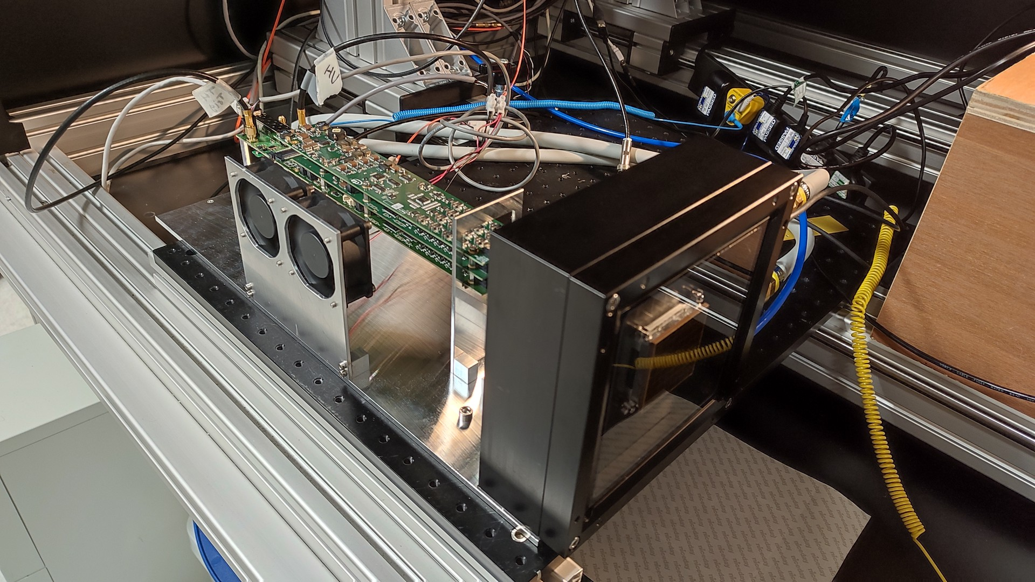
Conclusions and outlooks
Pretty good knowledge of the Validation Facility and its components
Dynamic range of laser source (FW calibration)
Description of laser beam
Improved knowledge of set-up
Fully working experimental set-up to host new SST cameras and/or other detectors
Fully working Managing Software for next users
Operating CHEC-S Camera
Known set-up and experimental settings (trigger delay, HV configuration) + scripts obtain them at anytime
Next steps… Use the DarkBox!
New 64-pixels module for the final SST Camera
Some examples…
gain calibration
pulse shape and timing
gain matching
PDE measurement of all 64 SiPMs

Slide 24
Bibliography and Sitography
«Development of a SiPM-based camera for the Large Size Telescope of CTA and study of its performance», D. Depaoli
«Cherenkov Camera and Analysis Development for Highest-Energy Gamma-Ray Astronomy», J. Zorn
«Commissioning and Performance of CHEC-S – a compact high-energy camera for the Cherenkov Telescope Array», J. Watson, J. Zorn
“The Small-Sized Telescopes for the Southern Site of the Cherenkov Telescope Array», R. White
https://www.rp-photonics.com/flat_top_beams.html

Slide 25
Thanks for the attention

Slide 26
Back-up

Slide 27
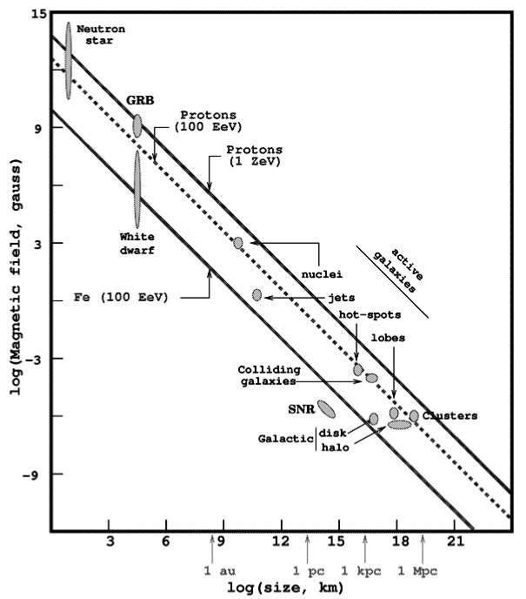
Cosmic Rays and showers
Hillas plot
Cherenkov light as e.m. shower develops

Slide 28
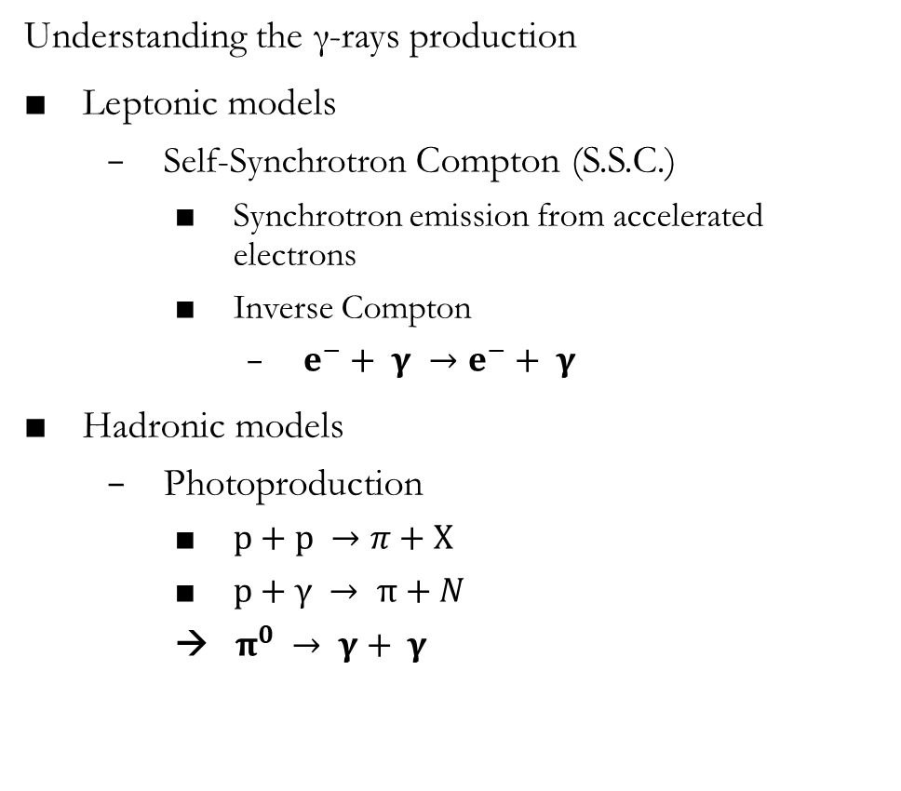
γ-rays production
Understanding the γ-rays production
Leptonic models
Self-Synchrotron Compton (S.S.C.)
Synchrotron emission from accelerated electrons
Inverse Compton
$e^{−}+ γ →e^{−}+ γ$
Hadronic models
Photoproduction
$p+p →π+X$
$p+γ → π+N$
→ $π^{0} → γ+ γ$
Spectral Energy Distribution

Slide 29


Reconstructing the shower
Analysis of VHE γ-ray observations: from raw data (measured charges in individual camera pixels) via camera images (characterised by e.g. the Hillas length, width, and amplitude) to final event lists, spectra, and images of sources
Image cleaning (removing pixels containing NSB signal)
Determination of Hillas parameters, parameterising the image ellipse with a width and length parameter, then scaled per telescope and, in stereoscopic systems, the mean over all triggered telescopes is found
γ-hadron separation: compare the extracted width and length of the shower image of telescope i to the mean values expected from γ -ray MC simulations, given their image amplitude, impact distance, zenith angle, et cetera
Shower image simulation on CHEC (sim_tel_array)

Slide 30


γ-hadron separation
Shower development simulation for γ- and proton-generated showers
Cherenkov light measure for γ- and proton-generated showers.
Accumulation ring (120 m approx.) for the gamma-induced one
Muon-induced rings in the proton-induced one

Slide 31

Silicon PhotoMultipliers
Semiconductors consisting of an array of avalanche photodiodes (APDs)
One pixel contains several thousands of diodes (microcells) with a size of few tens of μm
Each microcell: a PN junction supplied with a reverse bias voltage above breakdown (Geiger mode)
A photon or thermal excitation may produce an electron-hole pair in the depleted region
Charge carriers can trigger an avalanche in a microcell → high amplification of the incoming photon signal → one avalanche ∝ one electron-hole pair
Signal of one SiPM pixel: sum of the signal of all microcells, read out over their quenching resistor via a common output
SiPM outline

Slide 32
Silicon PhotoMultipliers
Main advantages
higher peak-PDE
magnetic-field independence
use of moderate voltages (70 V compared to 1000 V of MAPMs or PMTs)
robustness against high-background illuminations
better angular response
simple gain determination using SPE spectra from dark counts
Simpler manufacture and at a lower cost
active development of SiPMs
Main technical challenges
Temperature dependence (DCR and gain) → temperature stabilization is desirable
Optical Crosstalk
Sensitivity in the red

Slide 33
CTA and SST
CTA differential sensitivity (in Crab Nebula units), D. Depaoli

Slide 34

Night Sky Background
NSB measured at La Palma, Canary Islands, compared to the Cherenkov spectrum of a gamma-ray induced air shower. (D. Depaoli)

Slide 35



FW calibration procedure
Evaluate the transmission (1 MHz data) $T= \frac{Power @ Laser}{Maximum power @ Laser}$
Evaluate the expected number of photons at camera (1 MHz) via
$$n_{γ−exp}=T ∙k$$ with k evaluated as $$k=mean\left(\frac{n_{γ−cam−meas}@ FW pos.}{T @ FW pos.}\right)$$
Evaluate the expected number of photons at 600 Hz at camera via
$$n_{γ−cam} @ 600Hz=f ∙ n_{γ−exp}$$
With f evaluated as a scale factor between measurements at different rates
$$f= \frac{n_{γ }@ 600Hz @ laser}{n_{γ }@ 1MHz @ laser}$$

Slide 36



Considerations: correction on power values
The light coming from the source should be uniform along the sphere
Scan the laser beam along the sphere of radius equivalent to the distance from the source
Our measures: scan on a 2D plane (x-y plane) → some correction is needed
$$\overline{AB}=R ∙\overline{CD}$$
Measures of power have to be corrected by this R factor: in 2D this means $R_{x}$ and $R_{y}$ factors
$$R_{x,y}= \frac{d\left[\tan\left(α_{1x,y}+ ε\right) − tan({α_{1x,y})}\right]}{10.3 mm }$$
${power}_{plane}= {power}_{sphere}∙R_{x}$ $∙R_{y}$

Slide 37

Correction on power values
The correction factor is evaluated as the ratio between the sensor size on the sphere (CD) and the size it should have to see the same amount of light on the plane (AB)
$$R= \frac{AB}{CD}= \frac{d\tan{α_{2} −d\tan{α_{1}} }}{dα_{2} −dα_{1}}= \frac{d(\tan{α_{2} − \tan{α_{1})}}}{d∙ε }$$
Since CD = 10.3 mm (real sensor size), we have
$$ε=(10.3 ∙ {10 }^{−3} m)/d$$
Then
$α_{2}=α_{1}+ ε$
and
$α_{1x}=arctan\left[\frac{x − x_{0}}{d}\right]$ or $α_{1y}=arctan\left[\frac{y − y_{0}}{d}\right]$
Where (x,y) are the sensor position coordinates at each scan step (we assume they are located at the center of the sensor).

Slide 38



Correction on power values and final beam model procedure
Final procedure
Perform a first fit on data without any correction (origin of the sphere is unknown a priori)
One dimensional fit on the distribution of power along x = 0 and y = 0 with intuitively initialized parameters (function: 1D supergaussian)
Bidimensional fit on power data with initialization parameters obtained from previous 1D fit (function: 2D supergaussian)
With the newly found values of $\left(x_{0}, y_{0}\right)$ coordinates, evaluate the correction factors R and correct the data
Repeat the 2D fit on corrected data
This procedure can be repeated at anytime by the user giving the new sets of data and experimental premises (via configuration file)
Results from fit are saved both via plots and fit parameters
Distribution of correction factor $R_{x}$

Slide 39

Thorlabs diffusers

Slide 40
NSB beam
Not interested in knowing the NSB beam perfectly… But the model is working → some considerations
LED should deliver ≈ monochromatic light, with a peaked spectrum (peak-wavelenght λ = 405 nm): assume it as almost gaussian?
Same kind of circle tophat diffuser → final result should be a peaked function «flattened» by a tophat again
Data taken with same method
Tried re-using the supergaussian, expecting a different order n
Initial parameters slightly different
(x0, y0) no longer expected to be (0,0)
MIN and MAX filter cases should be the same, except for the amplitude value
→ Possibility to eventually use the same model on NSB beam

Slide 41





NSB beam
Data @ 1 m, MIN filter
$$χ^{2}=7.32 ∙ {10}^{−8} \\ n=0.829 ±0.006$$
Data @ 3 m, MIN filter
$$χ^{2}=1.76 ∙ {10}^{−9}$$
$$n=0.7501 ±0.0013$$
Beam uniformity: 8.11 %
Data @ 1 m

Slide 42




Additional correction on NSB values
Powermeter always measures at λ = 400 nm
LED light peaked at 405 nm
Data must be corrected
LED emission cannot be varied
Wavelength settings on the powermeter can → perform a «wavelength» scan over the entire wavelength range of PM (supplying a constant light)
Obtain the relative quantum efficiency (with reference value 400 nm) VS wavelength of the sensor
$${QE}_{R}= \frac{{QE}_{i}}{{QE}_{0}}=\frac{P_{0}}{P_{i}}∙ \frac{λ_{0}}{λ_{i}}$$
Correction on power measures will be the variation of QE at 405 nm w.r.t. reference value
Power and Relative quantum efficiency VS wavelength

Slide 43


Relative QE
Measured power is
$$P= \frac{E}{t}=\frac{N_{ph} ∙h ν}{t}= R_{ph} ∙hν$$
By definition
$$QE = \frac{R_{p.e.}}{R_{ph}} → R_{ph }= \frac{R_{p.e.}}{QE}$$
Then
$P=\frac{R_{p.e.}}{QE}∙hν$
The «peak power» (power @ 400 nm) is
$$P_{0}=\frac{R_{p.e.}}{{QE}_{0}}∙hν_{0}$$
Measure several other power values (@ different λ), while the rate of photoelectrons is always the same
$$P_{i}=\frac{R_{p.e.}}{{QE}_{i}}∙hν_{i}$$
Then
$$R_{p.e.}= {QE}_{0} ∙ P_{0} ∙ \frac{1}{h ν_{0}}$$
Define the relative quantum efficiency as
${QE}_{R}= \frac{{QE}_{i}}{{QE}_{0}}= \frac{P_{0}}{P_{i}} ∙ \frac{ν_{i}}{ν_{0}}=\frac{P_{0}}{P_{i}}∙ \frac{λ_{0}}{λ_{i}}$

Slide 44


From relative QE to relative responsivity
Definition of responsivity
$$ρ=QE ∙ \frac{e}{hν}$$
Relative responsivity
$$\frac{ρ_{i}}{ρ_{0}}= \frac{{QE}_{i}}{{QE}_{0}}∙ \frac{ν_{0}}{ν_{i}}=\frac{{QE}_{i}}{{QE}_{0}}∙ \frac{λ_{i}}{λ_{0}}$$
To be compared with data from manufacturer

Slide 45

CHEC-S
J. Zorn

Slide 46

CHEC-S
CHEC-S
SST Camera
32 identical camera modules connected to a single Backplane (BP).
Each camera module contains a SiPM tile with 64-pixels each of active size 6 mm x 6 mm.
Each tile is connected to Front-End Electronics (FEE) module that provides SiPM bias control, waveform digitisation and a first-level camera trigger.
R.White

Slide 47



Pixels’ «health»
1σ criterion
«Bad» pixels: 12.5%
2σ criterion
«Bad» pixels: 2.3%
3σ criterion
«Bad» pixels: 1.5%

Slide 48


CHEC-S – Dynamic range
Scan over a range of photon numbers
Here: pre-HV reconfiguration
The new HV settings should improve the error bars
Charge_SPE and PDE are not known for the current CHEC-S state (performance after many years and a commissioning)
PDE of MAPM (used in CHEC-M) and of Hamamatsu S10943-1071 SiPM (similar to the one used in CHEC-S) as function of the wavelength. (J. Zorn)
Extracted charge VS light from source

Slide 49
Longterm tests
Idea: repeat iteratively the fundamental steps of CHEC-S to study its stability
Stability in terms of pixels’ «health», uniformity, response, etc. as a function of time
Monitoring humidity and temperature
To be run ideally for months every night
«Longterm performance» of a prototype
Fundamental steps
Boot-up: turn on and off m times
Lid control
Dynamic range
Quick analysis and tiding up of data
Repeat n times
A posteriori analysis

Slide 50

DBM Monitoring: Graphana

